Slide 1


IMPLEMENTATION OF K-MEANS AND K-MEDOIDS CLUSTERING ALGORITHMS TO DETERMINE THE OPTIMAL ‘K’
Project Lab (CS 794) Group 4
Anisha Pal 14400113005
Supervised by Prof Subrata Bose
Department of Computer Science and Engineering
Neotia Institute of Technology, Management and Science
May 2017
8th Semester, 2013-2017 Batch

Slide 2
Contents
What is Clustering?
Applications of Clustering
Clustering Mechanisms
K-Means Clustering
Drawbacks of K-Means
K-Medoids
K-Mean vs K-Medoids
Finding The Optimal “k” in clustering
Elbow Method
Elbow Method - EXPERIMENTAL WORK
Elbow Method -Difference seen in results between K-means and K-medoids
Conclusion
References

Slide 3
What is Clustering?
Originated from “clyster”, meaning “clot”.
Cluster analysis or clustering is the task of grouping a set of objects in such a way that objects in the same group (called a cluster) are more similar (in some sense or another) to each other than to those in other groups (clusters).

Slide 4
Application of Clustering
Market research, pattern recognition and data analysis
Characterization of the customer groups based on the purchasing patterns.
Derivation of plant and animal taxonomies
Classifying documents on the web for information discovery.
Earth-quake studies
Climate: understanding earth’s climate, finding patterns of atmospheric and ocean.
Machine Vision and Image Processing.
Outlier Detection.

Slide 5
Clustering Mechanisms
Partitioning method
K-means algorithm
K-medoids algorithm
Hierarchical method
Agglomerative
Divisive

Slide 6
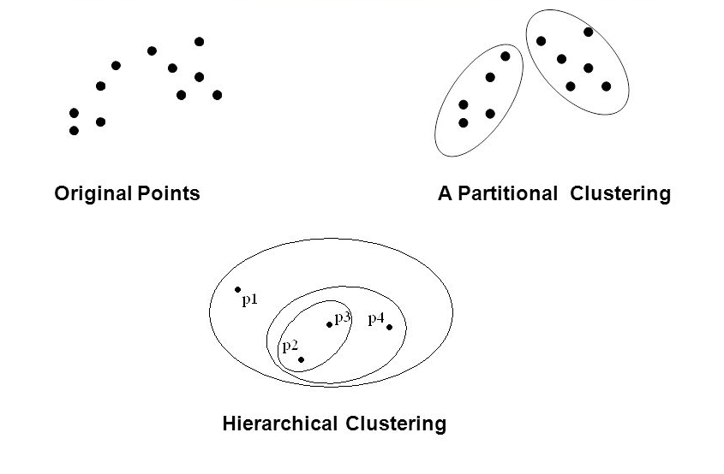
Clustering Mechanisms

Slide 7
K-Means Clustering
K-means is one of the unsupervised learning partitioning algorithms
It is also a method of vector quantization
K-means clustering aims to partition ‘n’ observations into ‘k’ clusters

Slide 8

K-Means Clustering
The cluster selection formula goes like,
where,
n is the number of objects or elements given,
k is the number of clusters given,
m_{j} is the mean of the j^{th} cluster,
o_{i} is the object/element from the input set O.
$$\sum_{i=1}^{n}{\sum_{j=1}^{k}{\left|m_{j}−o_{i}\right|}}$$

Slide 9
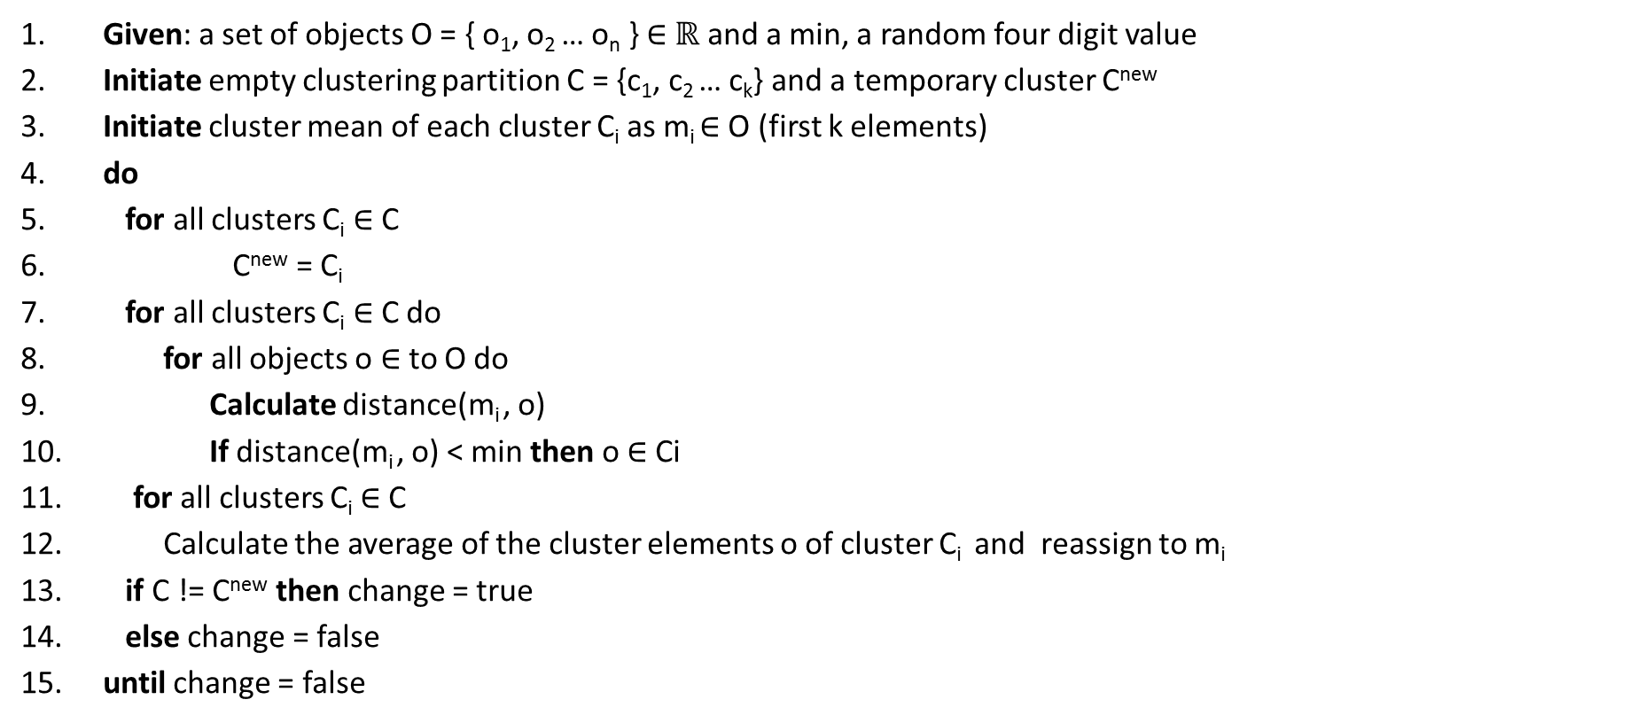
K-Means Clustering Algorithm
Given: a set of objects O = { o₁, o₂ … o_{n} } ∈ $ℝ$ and a min, a random four digit value
Initiate empty clustering partition C = {c₁, c₂ … c_{k}} and a temporary cluster C^{new}
Initiate cluster mean of each cluster C_{i} as m_{i} ∈ O (first k elements)
do
for all clusters C_{i} ∈ C
C^{new} = C_{i}
for all clusters C_{i} ∈ C do
for all objects o ∈ to O do
Calculate distance(m_{i} , o)
If distance(m_{i} , o) < min then o ∈ Ci
for all clusters C_{i} ∈ C
Calculate the average of the cluster elements o of cluster C_{i} and reassign to m_{i}
if C != C^{new} then change = true
else change = false
until change = false

Slide 10
K-Means Clustering Example
Let the input sequence be : 23 34 45 32 11 and k=3
Pass 1:
c1_mean :: 23
c2_mean :: 34
c3_mean :: 45

Slide 11
K-Means Clustering Example
Placing 23
abs(c1_mean - 23) = 0
abs(c2_mean - 23) = 11
abs(c3_mean - 23) = 22
Placed in c1
Let the input sequence be : 23 34 45 32 11
Pass 1:
c1_mean :: 23
c2_mean :: 34
c3_mean :: 45
c1: 23
c2:
c3:

Slide 12
K-Means Clustering Example
Placing 34
abs(c1_mean - 34) = 11
abs(c2_mean - 34) = 0
abs(c3_mean - 34) = 11
Placed in c2
Let the input sequence be : 23 34 45 32 11
Pass 1:
c1_mean :: 23
c2_mean :: 34
c3_mean :: 45
c1: 23
c2: 34
c3:

Slide 13
K-Means Clustering Example
Placing 45
abs(c1_mean - 45) = 22
abs(c2_mean - 45) = 11
abs(c3_mean - 45) = 0
Placed in c3
Let the input sequence be : 23 34 45 32 11
Pass 1:
c1_mean :: 23
c2_mean :: 34
c3_mean :: 45
c1: 23
c2: 34
c3: 45

Slide 14
K-Means Clustering Example
Placing 32
abs(c1_mean - 32) = 9
abs(c2_mean - 32) = 2
abs(c3_mean - 32) = 13
Placed in c2
Let the input sequence be : 23 34 45 32 11
Pass 1:
c1_mean :: 23
c2_mean :: 34
c3_mean :: 45
c1: 23
c2: 34, 32
c3: 45

Slide 15
K-Means Clustering Example
Placing 11
abs(c1_mean - 11) = 12
abs(c2_mean - 11) = 23
abs(c3_mean - 11) = 34
Placed in c1
Let the input sequence be : 23 34 45 32 11
Pass 1:
c1_mean :: 23
c2_mean :: 34
c3_mean :: 45
c1: 23, 11
c2: 34, 32
c3: 45

Slide 16
K-Means Clustering Example
Placing 23
abs(c1_mean - 23) = 6
abs(c2_mean - 23) = 10
abs(c3_mean - 23) = 22
Placed in c1
Let the input sequence be : 23 34 45 32 11
Pass 2:
c1_mean :: 17
c2_mean :: 33
c3_mean :: 45
c1: 23, 11
c2: 34, 32
c3: 45
c1: 23
c2:
c3:

Slide 17
K-Means Clustering Example
Placing 34
abs(c1_mean - 34) = 17
abs(c2_mean - 34) = 1
abs(c3_mean - 34) = 11
Placed in c2
Let the input sequence be : 23 34 45 32 11
Pass 2:
c1_mean :: 17
c2_mean :: 33
c3_mean :: 45
c1: 23, 11
c2: 34, 32
c3: 45
c1: 23
c2: 34
c3:

Slide 18
K-Means Clustering Example
Placing 45
abs(c1_mean - 45) = 28
abs(c2_mean - 45) = 12
abs(c3_mean - 45) = 0
Placed in c3
Let the input sequence be : 23 34 45 32 11
Pass 2:
c1_mean :: 17
c2_mean :: 33
c3_mean :: 45
c1: 23, 11
c2: 34, 32
c3: 45
c1: 23
c2: 34
c3: 45

Slide 19
K-Means Clustering Example
Placing 32
abs(c1_mean - 32) = 15
abs(c2_mean - 32) = 1
abs(c3_mean - 32) = 13
Placed in c2
Let the input sequence be : 23 34 45 32 11
Pass 2:
c1_mean :: 17
c2_mean :: 33
c3_mean :: 45
c1: 23, 11
c2: 34, 32
c3: 45
c1: 23
c2: 34, 32
c3: 45

Slide 20
K-Means Clustering Example
Placing 11
abs(c1_mean - 11) = 6
abs(c2_mean - 11) = 22
abs(c3_mean - 11) = 34
Placed in c1
Let the input sequence be : 23 34 45 32 11
Pass 2:
c1_mean :: 17
c2_mean :: 33
c3_mean :: 45
c1: 23, 11
c2: 34, 32
c3: 45
c1: 23, 11
c2: 34, 32
c3: 45

Slide 21
K-Means Clustering Example
Let the input sequence be : 23 34 45 32 11
old cluster new cluster
No change in clusters indicates the end of process – convergence!
c1: 23, 11
c2: 34, 32
c3: 45
c1: 23, 11
c2: 34, 32
c3: 45

Slide 22
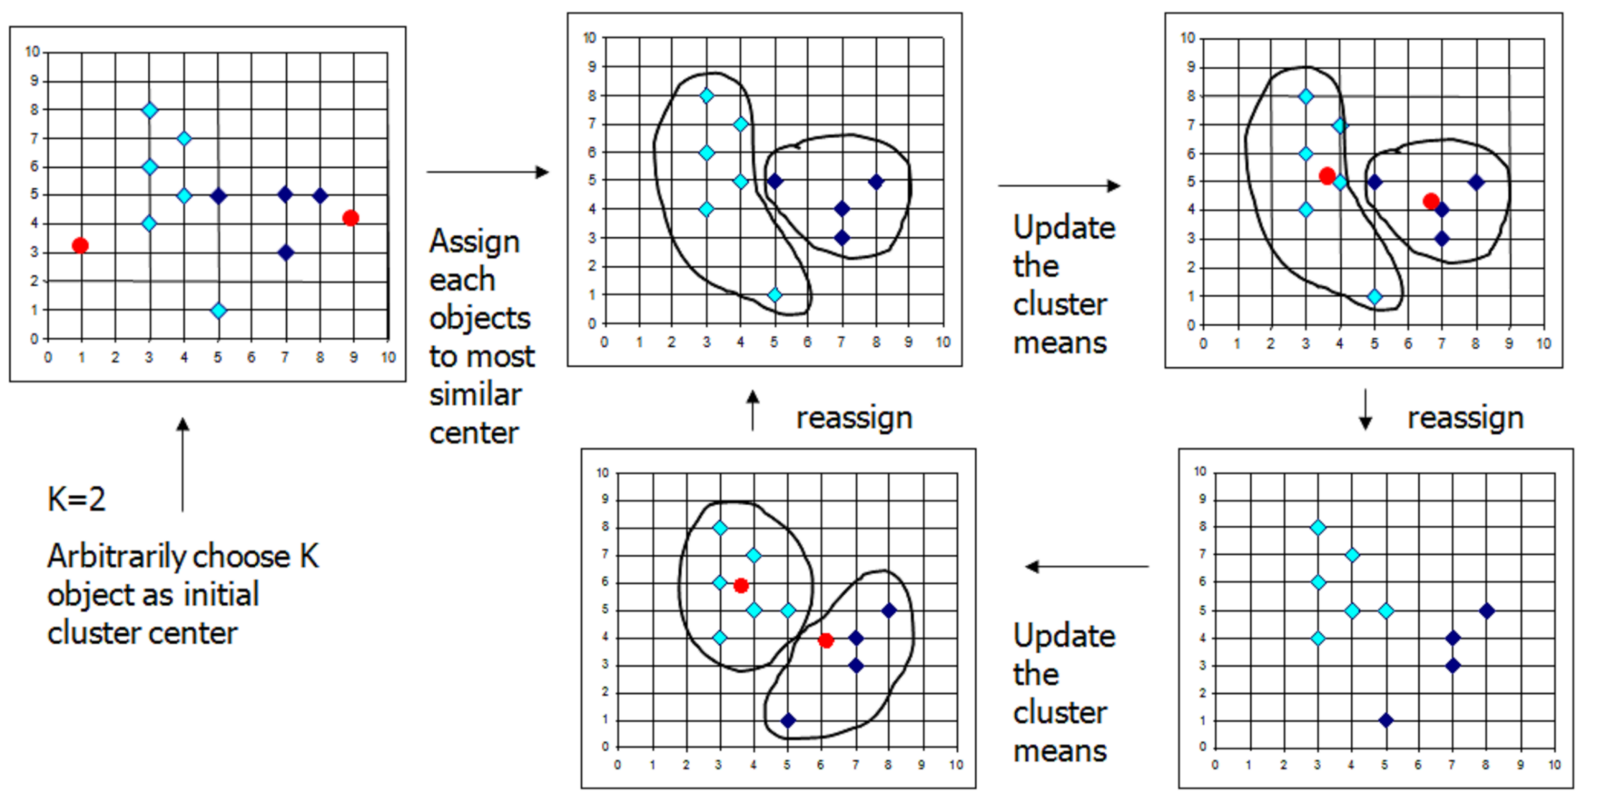
K-Means Clustering

Slide 23
Where is Learning in K-Means ?
Each object is assigned automatically to one of the cluster
This is a trait of “unsupervised learning”
The learning process depends on the training examples that we give
Thus after the training finished, if we give a point, the algorithm can assign this point to one of the existing distribution

Slide 24
Drawbacks of K-Means
When the numbers of data are not so many, initial grouping will determine the cluster significantly.
The number of cluster, K, must be determined before hand.
We never know the real cluster, using the same data, if it is inputted in a different way may produce different result
Finding mean is sensitive to the outlier of each cluster

Slide 25
K-Medoids
In K-medoids clustering representative objects called medoids are considered instead of centroids
Because it is based on the most centrally located object in a cluster, it is less sensitive to outliers.
Among many algorithms for K-medoids clustering, Partitioning Around Medoids (PAM) proposed by Kauf-man and Rousseeuw (1990) is known to be most powerful

Slide 26
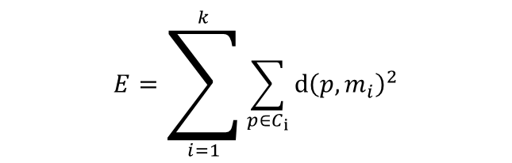
K-Medoids Clustering
Swapping Cost
For each pair of a medoid m and a non-medoid object p, measure whether p is better than m as a medoid
Using the squared-error criterion :
Compute E_{p}-E_{m.}
Choose the minimum swapping cost.
$$E=\sum_{i=1}^{k}{\sum_{p∈C_{ⅈ}}{ⅆ{\left(p,m_{i}\right)}^{2}}}$$

Slide 27
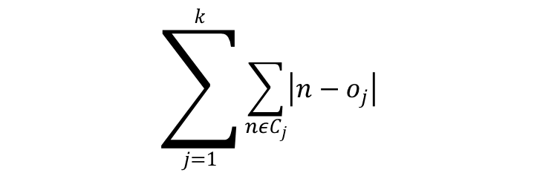
K-Medoids Clustering
The cluster selection formula goes like,
where,
n is the number of objects or elements given,
k is the number of clusters given,
C_{j} is the j^{th} cluster,
o_{j} is the object/element from the input set O.
$$\sum_{j=1}^{k}{\sum_{nεC_{j}}{\left|n−o_{j}\right|}}$$

Slide 28
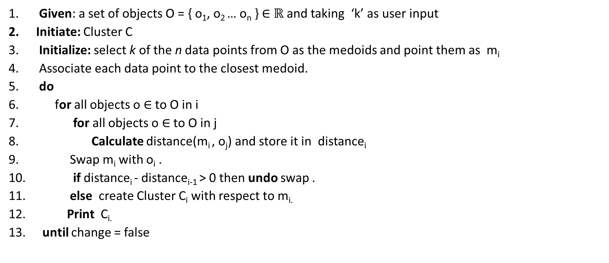
K-Medoids Clustering Algorithm
Given: a set of objects O = { o₁, o₂ … o_{n} } ∈ $ℝ$ and taking ‘k’ as user input
Initiate: Cluster C
Initialize: select k of the n data points from O as the medoids and point them as m_{i}
Associate each data point to the closest medoid.
do
for all objects o ∈ to O in i
for all objects o ∈ to O in j
Calculate distance(m_{i} , o_{j}) and store it in distance_{i}
Swap m_{i} with o_{i} .
if distance_{i} - distance_{i-1} > 0 then undo swap .
else create Cluster C_{i} with respect to m_{i.}
Print C_{i.}
until change = false

Slide 29
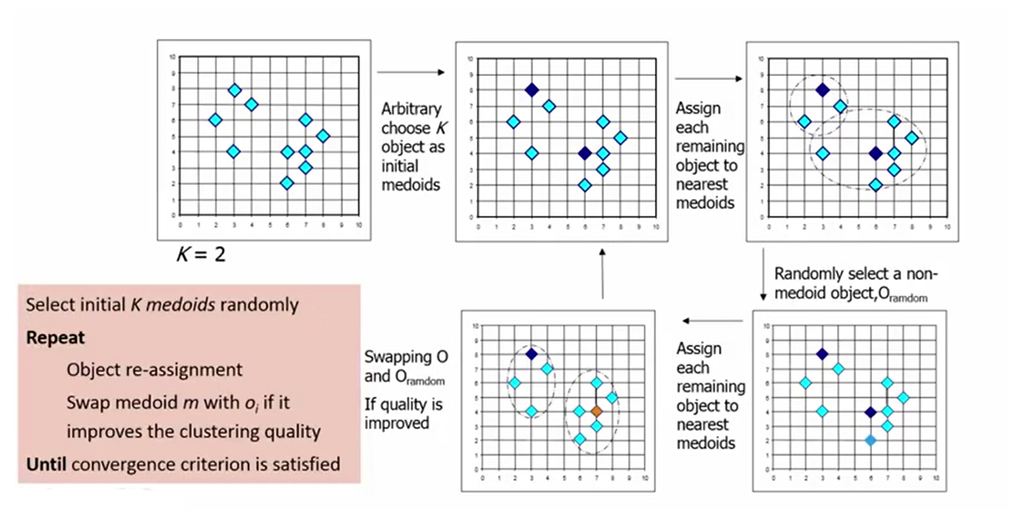
K-Medoids

Slide 30
K-Means vs K-Medoids
k-means will select the "center" of the cluster, while k-medoid will select the "most centered" member of the cluster.
In a cluster with outliers k-means will place the center of the cluster towards the outliers, whereas k-medoid will select one of the more clustered members (the medoid) as the center.
Usually, PAM takes much longer to run than k-means. As it involves computing all pairwise distances, it is O(n²*k*i); whereas k-means runs in O(n*k*i) where usually, k times the number of iterations is k*i << n.

Slide 31
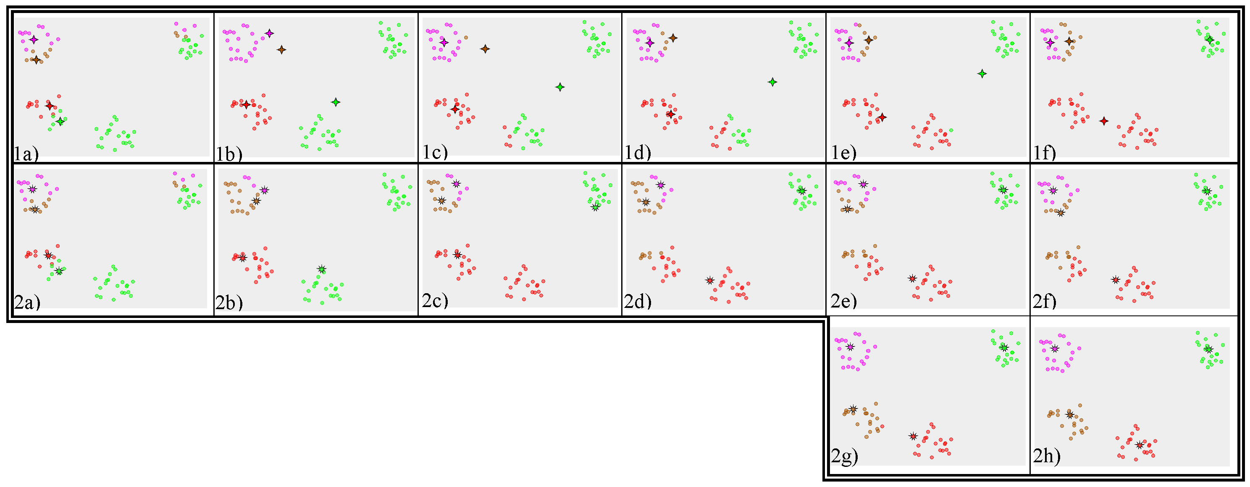
K-Means vs K-Medoids

Slide 32
Finding The Optimal “k” in clustering
There are three popular methods for determining optimal number of clusters
Elbow Method
Average Silhouette method
Gap statistic method
In this project, the Elbow method which is a variance based approach is implied.

Slide 33
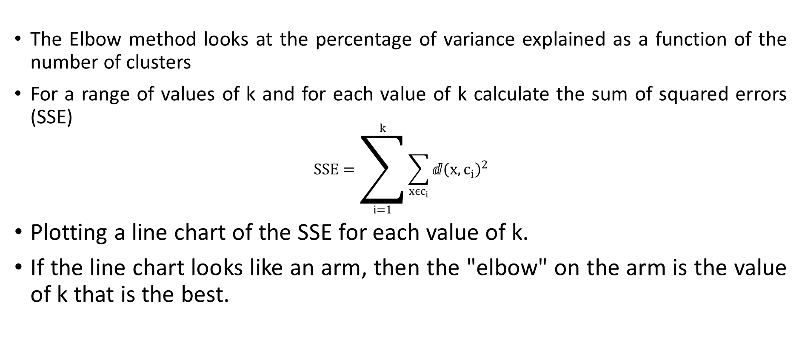
Elbow Method
The Elbow method looks at the percentage of variance explained as a function of the number of clusters
For a range of values of k and for each value of k calculate the sum of squared errors (SSE)
$$SSE=\sum_{i=1}^{k}{\sum_{xϵc_{i}}{ⅆ{\left(x,c_{i}\right)}^{2}}}$$
Plotting a line chart of the SSE for each value of k.
If the line chart looks like an arm, then the "elbow" on the arm is the value of k that is the best.

Slide 34
Finding Elbow point : Algorithm
Given: Taking elements from a file consisting of 2-Dimension data
After calculating cluster centroid, take the difference or error or ‘d’ of every element to the centroid.
Then summing up the errors or ‘d’ of each cluster number and storing in SUM_{i}.
If k! =1 then sum up SUM_{i} with SUM_{i-1} and then with SUM_{k} and store in SSE.
Printing SSE.
Opening Excel Sheet to produce a graph to notice the elbow point.

Slide 35
Working with 12 elements as an input (for both k-means and k-medoids):
Elbow Method - EXPERIMENTAL WORK-I
185 | 72
170 | 56
168 | 60
179 | 68
182 | 72
188 | 77
180 | 71
180 | 70
183 | 84
180 | 88
180 | 67
177 | 76

Slide 36
Output generated: SSE value calculated
Elbow Method (K-means)- EXPERIMENTAL WORK-I
NUMBER OF CLUSTERS | SUM OF SQUARED ERROR
1 | 98.45
2 | 69.37
3 | 64.907
4 | 36.12
5 | 27.128
6 | 23.23
7 | 20.627
8 | 13.245
9 | 7.414
10 | 2.414
11 | 1.00

Slide 37
Output generated: SSE value calculated
Elbow Method (K-medoids)- EXPERIMENTAL WORK-I
NUMBER OF CLUSTERS | SUM OF SQUARED ERROR
1 | 121
2 | 79
3 | 51
4 | 39
5 | 31
6 | 23
7 | 16
8 | 12
9 | 6
10 | 3
11 | 1

Slide 38
Output generated: SSE value plotted to form Elbow Curve
Elbow Method (K-means)- EXPERIMENTAL WORK-I
Elbow point is seen to be at 4 . Therefore, the optimal k is 4

Slide 39
Output generated: SSE value plotted to form Elbow Curve
Elbow Method (K-medoids)- EXPERIMENTAL WORK-I
Elbow point is seen to be at 3 . Therefore, the optimal k is 3

Slide 40
Input: Working with 240 elements and have chosen first 10 elements
Output : SSE value calculated
Elbow Method (K-means)- EXPERIMENTAL WORK-II
NUMBER OF CLUSTERS | SUM OF SQUARED ERROR
1 | 1052.072
2 | 785.127
3 | 643.3415
4 | 490.285
5 | 451.5178
6 | 410.459
7 | 373.8852
8 | 342.1152
9 | 326.2282
10 | 319.0226

Slide 41
Input: Working with 240 elements and have chosen first 10 elements
Output : SSE value calculated
Elbow Method (K-medoids)- EXPERIMENTAL WORK-II
NUMBER OF CLUSTERS | SUM OF SQUARED ERROR
1 | 2630966.484
2 | 1746431.322
3 | 1107771.003
4 | 895474.0886
5 | 1018454.334
6 | 805811.0467
7 | 751575.5183
8 | 735398.0523
9 | 678553.4726
10 | 640443.8868

Slide 42
Output generated: SSE value plotted to form Elbow Curve
Elbow Method (K-means)- EXPERIMENTAL WORK-II
Elbow point is seen to be at 4 . Therefore, the optimal k is 4

Slide 43
Output generated: SSE value plotted to form Elbow Curve
Elbow Method (K-medoids)- EXPERIMENTAL WORK-II
Elbow point is seen to be at 4 . Therefore, the optimal k is 4

Slide 44
Input: Working with 500 elements and have chosen first 10 elements
Output : SSE value calculated
Elbow Method (K-means)- EXPERIMENTAL WORK-III
NUMBER OF CLUSTERS | SUM OF SQUARED ERROR
1 | 3.34E+06
2 | 2.20E+06
3 | 1.38E+06
4 | 1.14E+06
5 | 1.06E+06
6 | 1.00E+06
7 | 927656
8 | 868344
9 | 817587
10 | 761930

Slide 45
Input: Working with 500 elements and have chosen first 10 elements
Output : SSE value calculated
Elbow Method (K-medoids)- EXPERIMENTAL WORK-III
NUMBER OF CLUSTERS | SUM OF SQUARED ERROR
1 | 2630966.484
2 | 1746431.322
3 | 1107771.003
4 | 895474.0886
5 | 1018454.334
6 | 805811.0467
7 | 751575.5183
8 | 735398.0523
9 | 678553.4726
10 | 640443.8868

Slide 46
Output generated: SSE value plotted to form Elbow Curve
Elbow Method (K-means)- EXPERIMENTAL WORK-III
There is an ambiguity while choosing k. We can see there are two elbow points 3 and 5.

Slide 47
Output generated: SSE value plotted to form Elbow Curve
Elbow Method (K-means)- EXPERIMENTAL WORK-III
There is an ambiguity while choosing k. We can see there are two elbow points 3 and 5.

Slide 48
Elbow Method -Difference seen in results between K-means and K-medoids
Elbow method result from k-medoids are more robust to noise and outliers than that of k-means.
SSE values from K-medoids are somehow found to be lesser than that of K-means since precisely the clusters are formed
K-medoids gives a proper elbow point and in case of K-means some (can be negligible) elbow points are shown i.e. ambiguous elbow points are found.

Slide 49
Conclusion
This Elbow method has huge space complexity as the cluster numbers are incremented from 1 to n (number of elements) and then SSE calculation per k.
K-means are fast and efficient in terms of computational cost, typically O(K*n*d) but in case of K-medoids takes huge time
During this project, I got output after 24 hours for each experiment (elements exceeding 100)
K-medoids are efficient since it rarely produce ambiguity in finding k.

Slide 50
References
https://en.wikipedia.org/wiki/Cluster_analysis
Data Mining: Concepts and Techniques, Jiawei Han.
https://sites.google.com/site/dataclusteringalgorithms/k-means-clustering-algorithm
https://en.wikipedia.org/wiki/K-means_clustering
https://en.wikipedia.org/wiki/K-medoids
https://www.researchgate.net/publication/220215167_A_simple_and_fast_algorithm_for_K-medoids_clustering
www.google.com/images
www.bing.com/images

Slide 51
Thank You..

